Slide 1



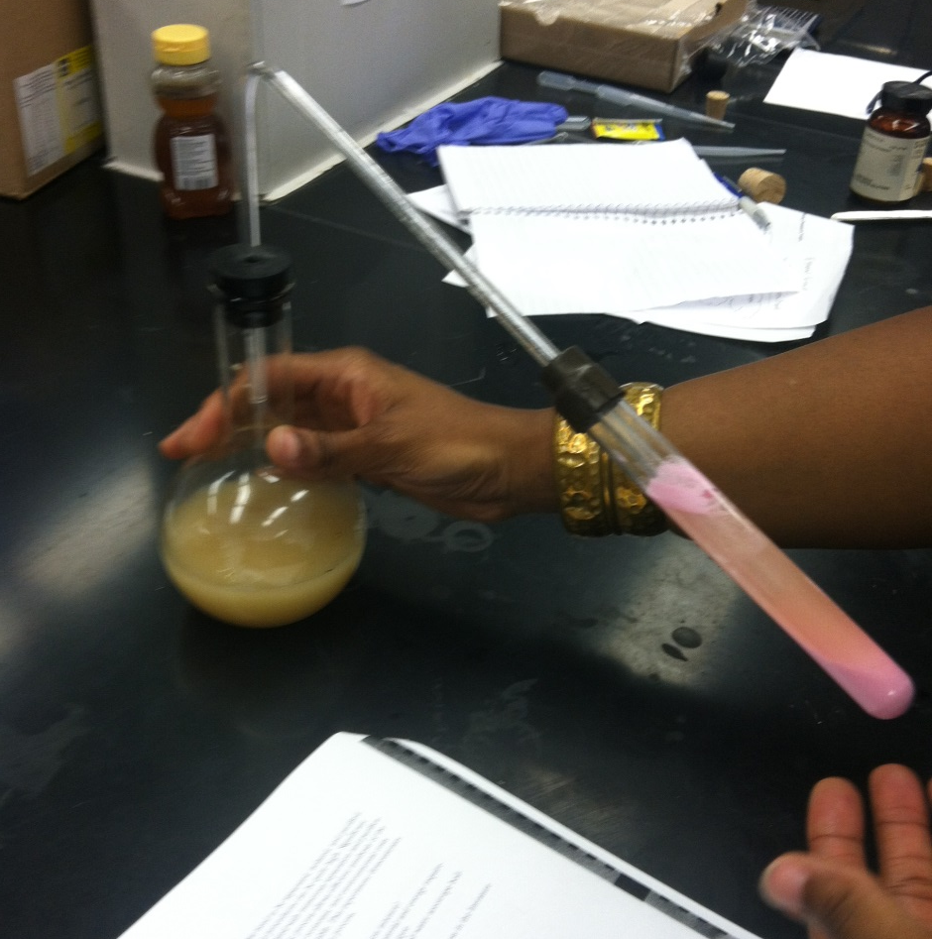
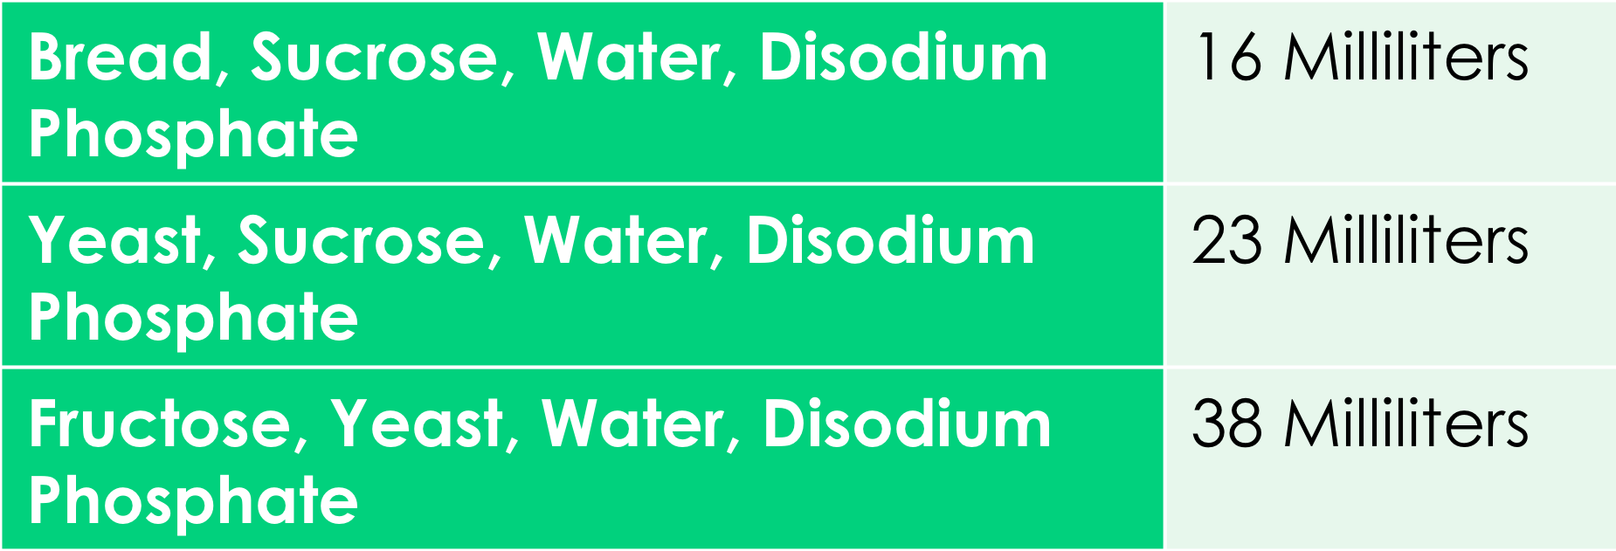
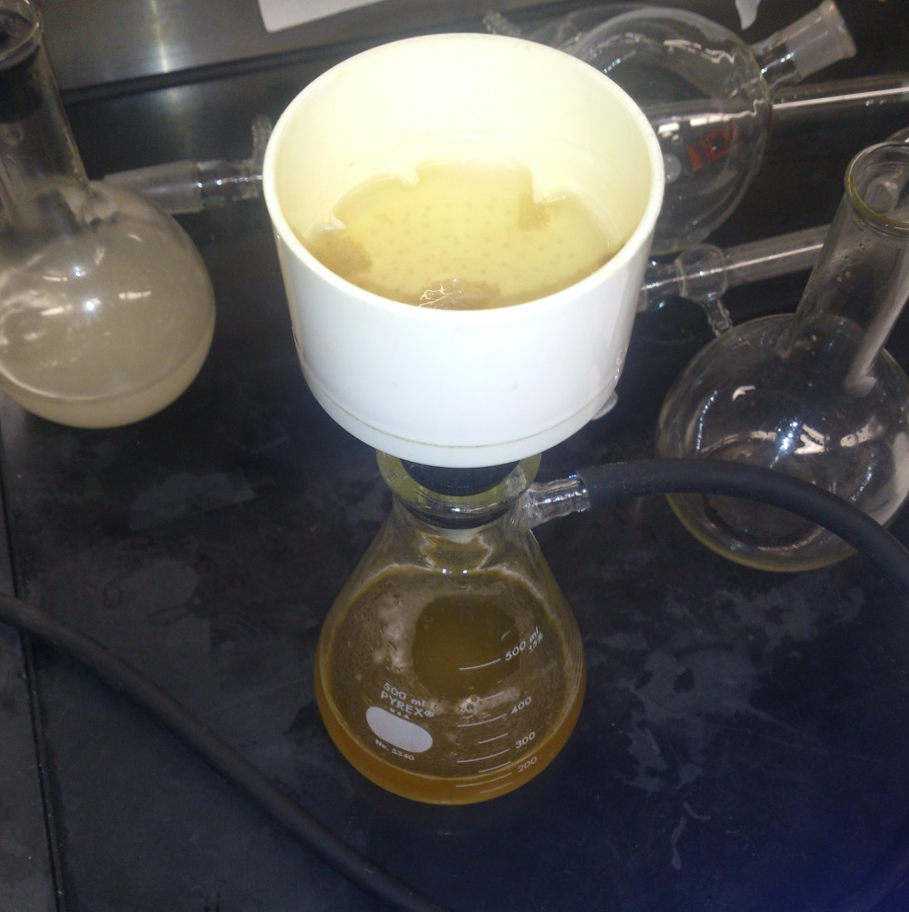
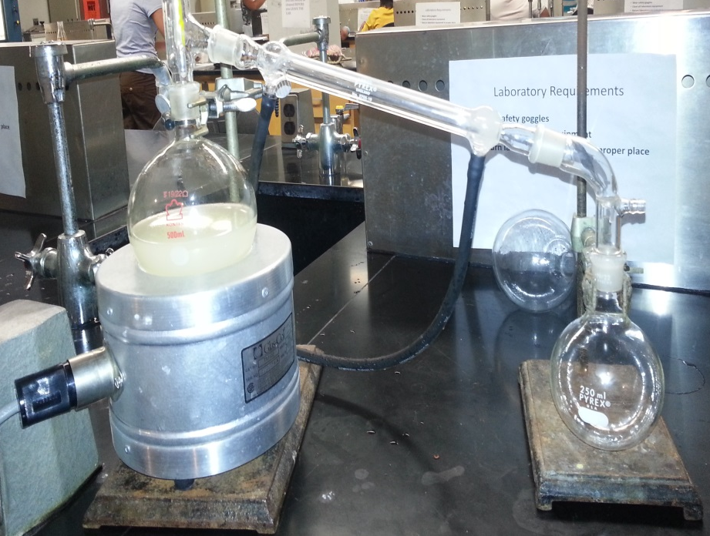
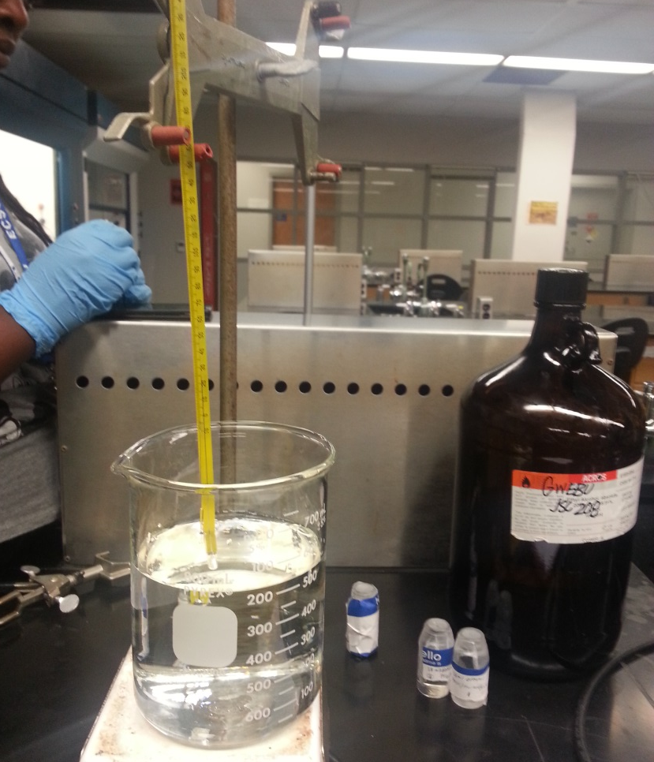
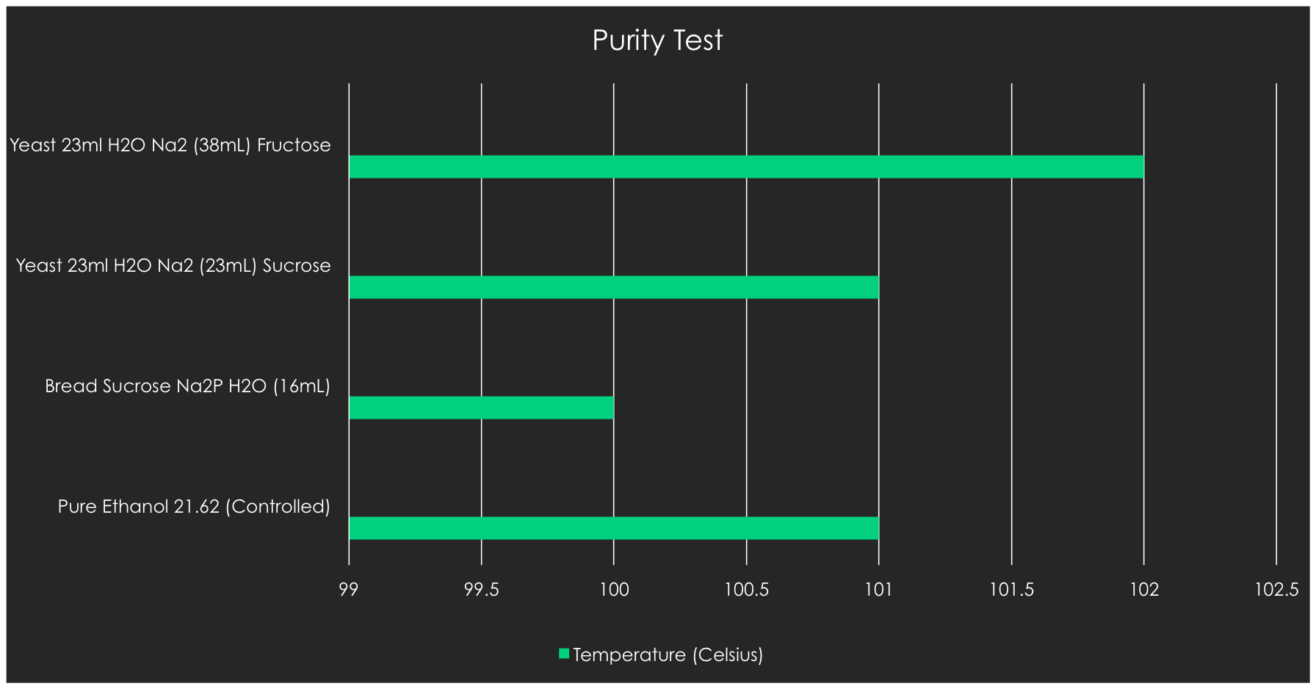
The Biosynthesis of Ethanol
Nigel Pugh, Timothy Berry, Shayla Evans, and Tiarra Williams Elizabeth City State University, Elizabeth City, NC
Abstract
Introduction
Methodology
Results
Ethanol is renewable source in ferment and distilled liquids. Ethanol can be found in cleaning solvents, medicines, colognes, and aftershave. Ethanol is a benefit in gasoline; it helps lower carbon dioxide, hydrocarbon, and nitrogen emissions. Ethanol is a clean-burning alternative to gasoline. It can be beneficial to the skin because it acts as a cooling agent on the skin. The purpose of this project was to test and see which mixture would make the most ethanol and which solution would be the purest to actual ethanol. The mixture of fructose, yeast water and disodium phosphate produced the most ethanol with 38 milliliters. The mixture of yeast, sucrose, water and disodium phosphate was the purest in form to ethanol. In the future, a common interest will be to find ways to produce ethanol at a faster pace and at a more abundant amount.
Fermentation
Fermentation is a chemical breakdown of a substance by yeast or other microorganisms
Used for thousands of years for baking and brewing
What is Ethanol Used For?
Solvent used in medicines, cleaning solutions, colognes, and after shave
Clean burning alternative to gasoline
Most gas in the United States is blended with Ethanol
The most ethanol currently in gasoline is 15%
What is Ethanol?
An intoxicating agent used in fermentation and distilled liquids
Used in beer and wines
Most widely used in biofuels
Comes from two main sources: Sugarcane and corn
Renewable/Non-Renewable Sources
Non-Renewable
Resources that cannot be replaced once supply is used up
Examples: Oil, Uranium, and Coal
Renewable
Sources that can be replaced once they are used up
Examples: Soil, Water, and Sunlight
Make 500 milliliter flasks of sucrose, yeast, disodium phosphate, and water ; bread, sucrose, disodium phosphate, and water; and fructose, disodium phosphate, water, and yeast (Following packet)
Connect flask with glass rod to test tube of calcium carbonate
Let it ferment overnight
Amount of Distilled Ethanol
Prepare filter paper in Buchner funnel for filtering
Pour fermented solution through Buchner funnel while running vacuum to remove solids
Purpose of Study
Set up distillation apparatus (make sure all parts match)
Pour each solution 19/22 or 22/40 500 milliliter flasks
Set flasks in heating mantle
(set on ringstands)
Collect each ethanol sample from each solution
Synthesize ethanol from various sources and determine which source produces the most ethanol and the purest ethanol in comparison to absolute ethanol
Acknowledgements
Special thanks to:
V.E.S.T.E.M. and the L.S.A.M.P. programs and the mentors involved, Mrs. Shanta Outlaw, Ms. Jennifer Vanwyck, Mr. Raynard Townsel, Mrs. Prudentia Ngwainbi Dean Harry Bass, and Dr. Ali Khan for making all this possible and aiding in the research and analysis process. This would not have happened without all your help and support.
Dip a capillary tube into each ethanol solution
Boil 500 milliliters of water while inserting capillary tubes beside thermometer into the water
Check tubes to see at what temperature the ethanol boils
References
Hypothesis
(n.d.). Retrieved from http://wordnetweb.princeton.edu/perl/webwn?s=ethanol
Dictionary Team. (n.d.). Retrieved from http://dictionary.reference.com/browse/distillation?s=t
Kimbrough, Doris. Fermentation and Distilation. Lab. Wilmington, NC: University of North Carolina at Wilmington, 2000. Document.
Meton, Raja. "Organic Chemistry Lab 1: Biosynthesis of Ethanol." Lab. 2004.
Thompson, John. The Biosynthesis of Ethanol. Lab . Eugene, Oregon: Lane Community College, n.d. Document.
Weeks, M.G. Aspects of Fermentation and Distillation. PhD Thesis. Auckland, New Zealand, n.d. Document.
Kirchoff, M., & Ryan, M. A. (2002). Greener approaches to undergraduate chemistry experiments.. Washington, D.C.: American Chemical Society.
The bread, sucrose, water, and disodium phosphate mixture would produce the most distilled pure ethanol in comparison to pure ethanol itself.

