Slide 1
STEM: Best Practices in the East
STEM IS IN, IN THE EASTERN AREA !!!!!!

Slide 2
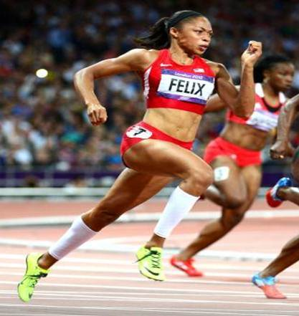
Mentoring Model ~ Mathematics Sprint Competition
Mathematics Sprint Competition is a fun way to improve attitudes towards mathematics and improve scores on mathematics standardized test.

Slide 3
Service Delivery Model
Sprint Mathematics Competition
Situation:
Poor Mathematics Performance of Minorities Standardized Tests
{
Inputs/
Resources
Outputs
Outcomes
Activities
Participation
Short Term
Medium Term
Long Term
In order to
accomplish
our set of
activities we will need:
To address the
problem, we will
accomplish the
following activities
Clients
We are
Serving
Expected
Changes
1-2 Years
Expected
Changes
3-4 Years
Behavorial
Changes
Partnership with
Inner City Schools
Teachers to provide
old SOL questions
Links to oversee
competition, explain
rules, score answers
Money to purchase
trophies and plan
awards ceremony
Select teams of
students to
compete in SOL
mathematics
competition.
Give feedback to
teachers on
problems missed
Sponsor award
ceremony for
competition
Conduct in several
schools.
Fourth-grade
students at
inner city schools
that have
performed
poorly on SOL
tests.
Students become
engaged with
and enjoy math
because of
competition.
Students learn
from each other
in teams.
Student scores
on SOL tests
will increase.
Students no longer
feel they cannot do
math.
Students will enjoy
taking and being
more successful
in mathematics
classes.
Many students
achieve higher
competency in
mathematics.
High ability
students will
likely consider
entering STEM
career areas
Assumptions
Evaluations/ Indicators
External Factors
Students often don’t learn
because of boredom or
lack of understanding.
Students will become more
engaged if they are having fun.
4th Grade SOL Test Scores
Track Students Classroom grades
8th grade test scores
High school classes in mathematics
Parental support
Teacher credentials

Slide 4
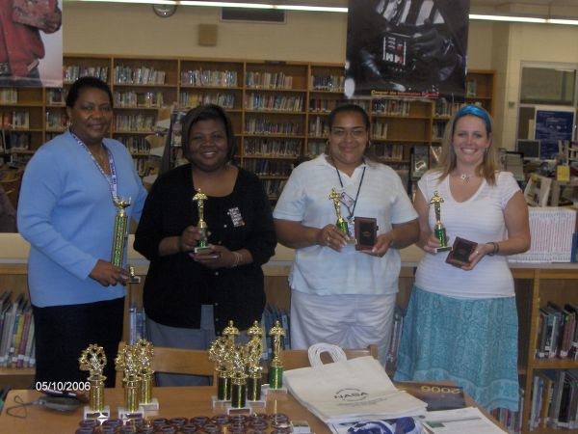
Engaging Youth in Mathematics Competition to inspire achievement (Mathematics Sprint Model)
• Partner with a local school
MOA signed by the principal and chapter president *
Identification of teachers and classes to participate
• School Provides
Recognition of team winners at the school honors program
20 multiple choice mathematics questions from past Standardized Test
Access to students
Assignment of students to groups of 3-5
Answers to the questions
• The LINKS Chapter provides
Team mentors
Trophies and certificates or medals
Scratch Paper and Pencils
Scoring assistance
Feedback for teachers

Slide 5
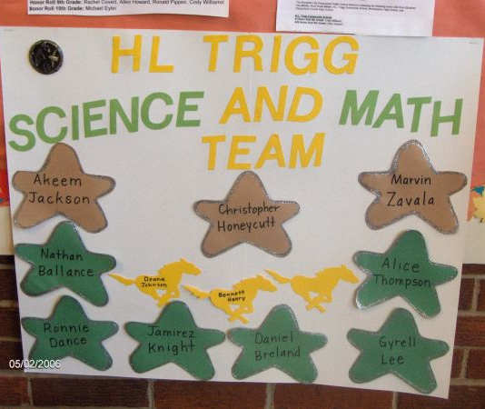
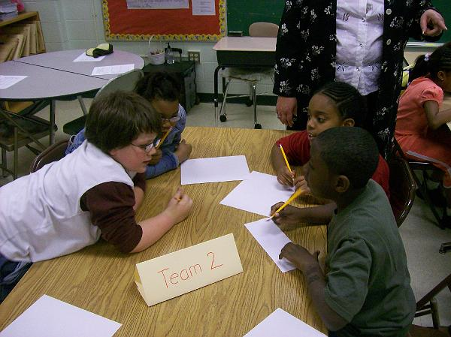
Students form teams of 3-5 students. They select a team name or are given a team number. That name or number must be written on each answer turned in.

Slide 6
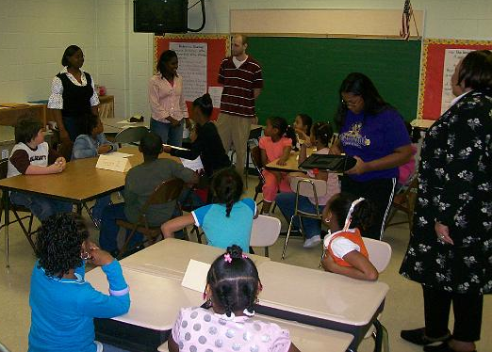
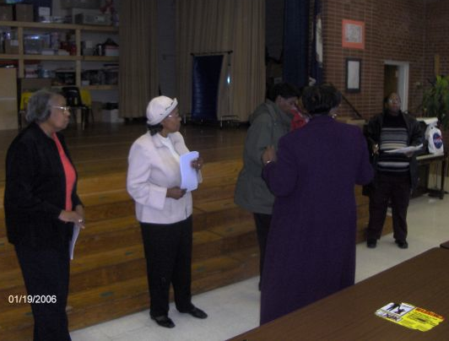
Students are introduced to their team mentors and are given competition rules
1. The problems are consecutively numbered 1 through 20.
2. All teams will begin with problem 1, then 2, then 3, etc.
A team receives another problem only after turning in the previous problem.
4. A team receives 1 point for each correct solution.
5. A team receives 0 points for an incorrect solution.
A problem turned in with no solution yields -1 points.
Your team name should be on each answer submitted.
8. You have 50 minutes.

Slide 7
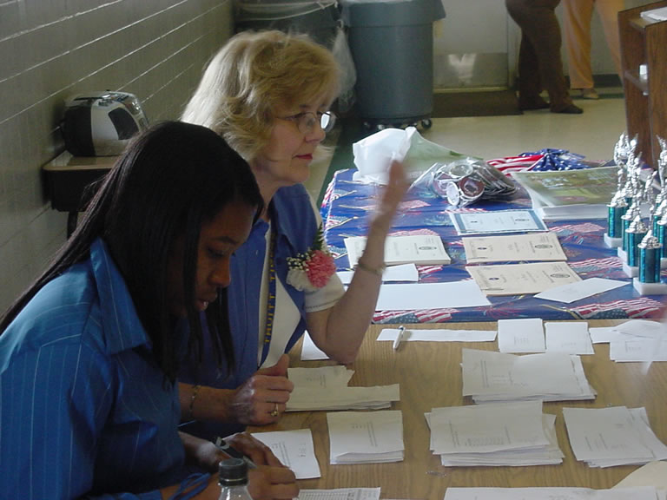
Grading sheets are used to record team scores. The team with the highest score wins. Encourage them to try to answer each question

Slide 8
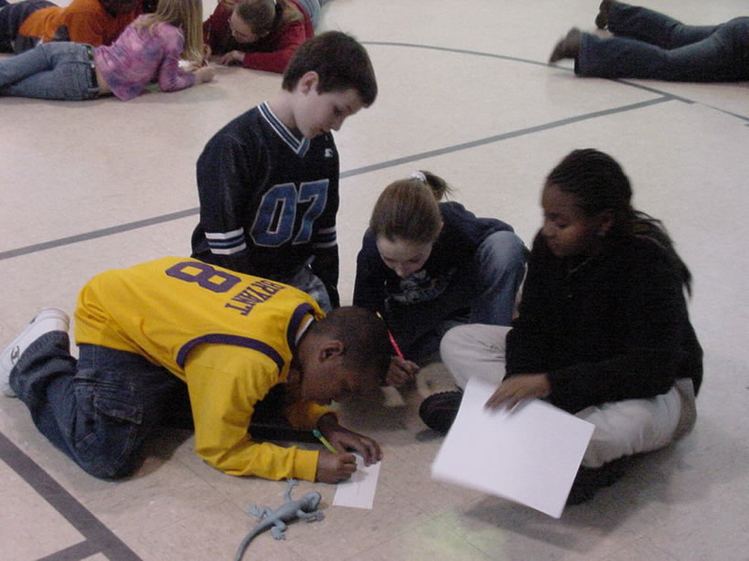
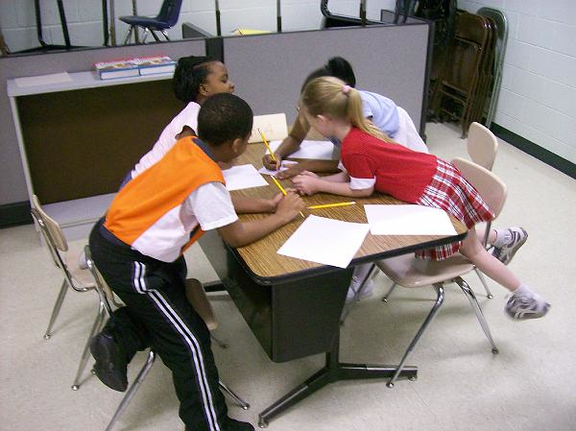
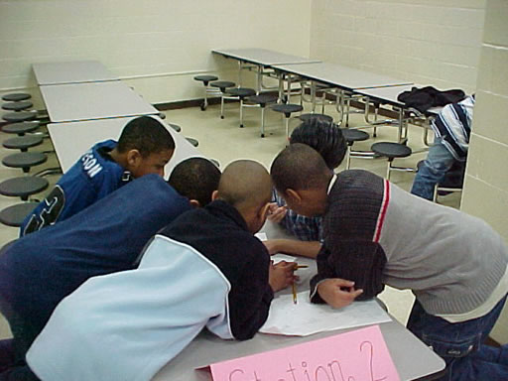
Students work collaboratively bringing their collective wisdom to bear on the problems. The team must agree on a final answer before giving the answer to the team runner.

Slide 9
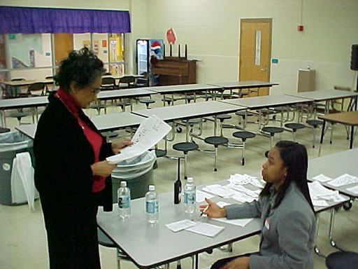
Grading sheets are used to record team scores. The team with the highest score wins. Encourage them to try to answer each question… 2 points for correct answers and subtract 1 point for wrong answers. One point is subtracted from the score if a team does not provide an answer or does not attempt to answer the question.

Slide 10
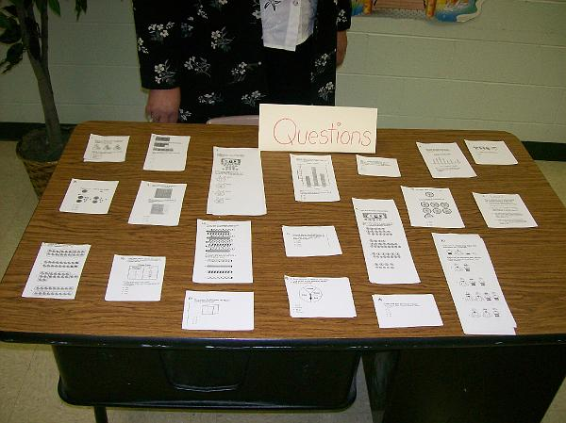
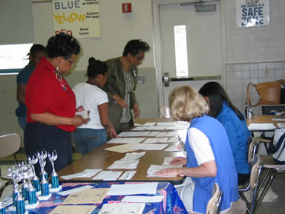
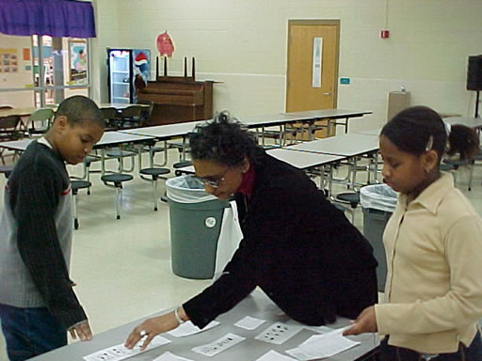
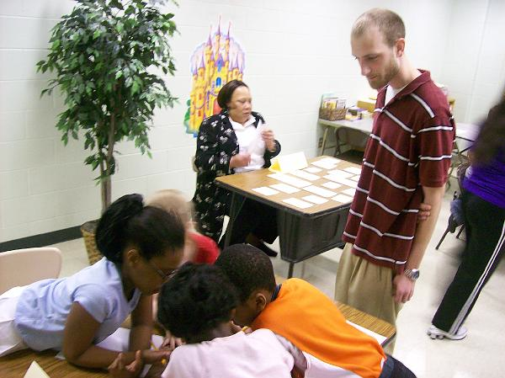
LETS
GO!

Slide 11
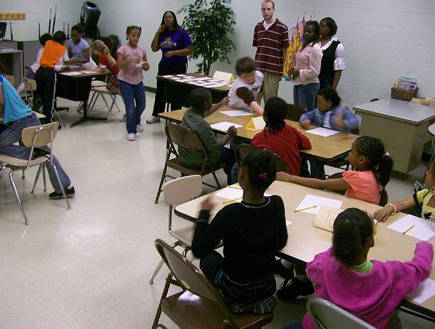
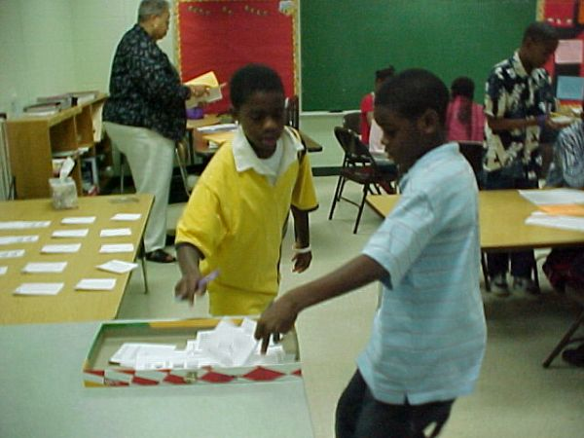
Students select a runner who picks up the questions, returns to their team, returns the team answer to the proctor and picks up the next question.

Slide 12
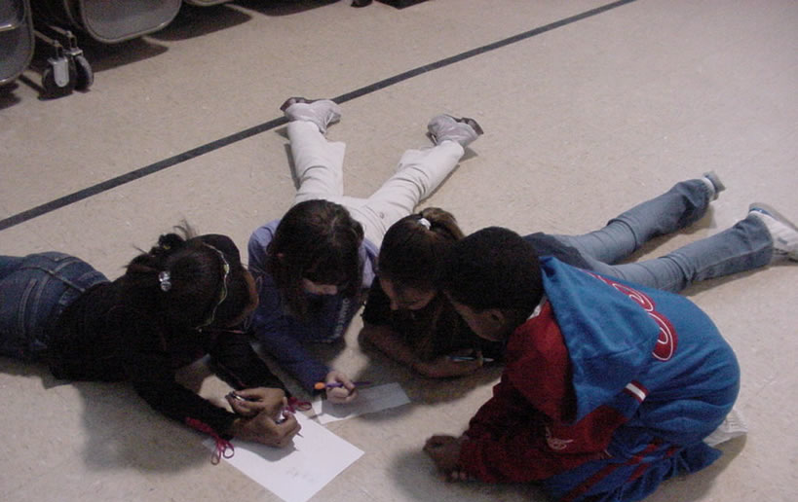
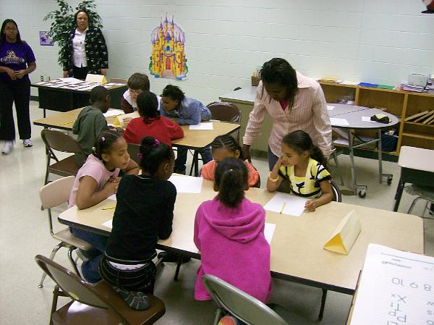
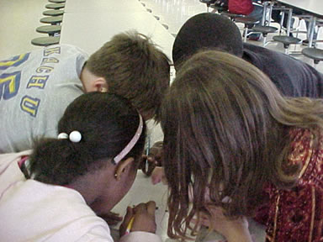
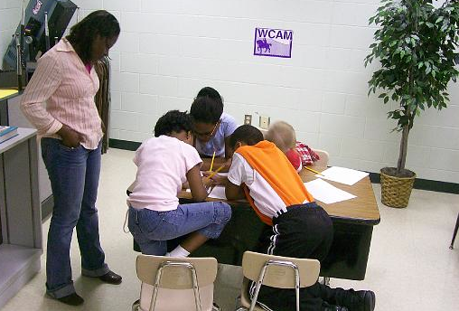
Team mentors do not assist in answering the questions but encourages the team to discuss the question and talk through it.

Slide 13
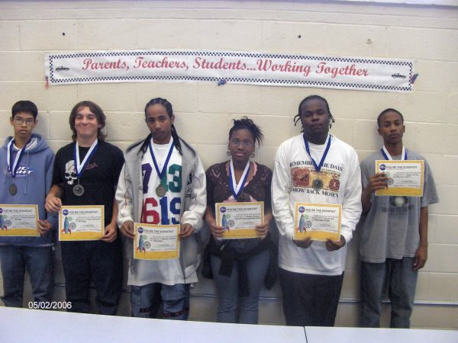
• Members of the winning team receive certificates.
• Several ”practice sprints” are encouraged before the final competition during which trophies are awarded.
• Between the math sprint competitions teachers are encouraged to cover material for questions that all teams missed.

Slide 14
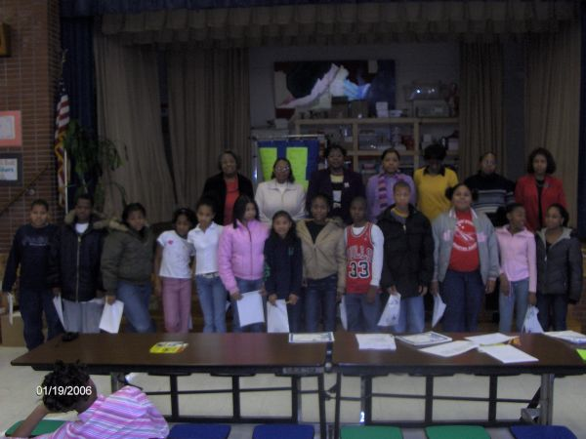
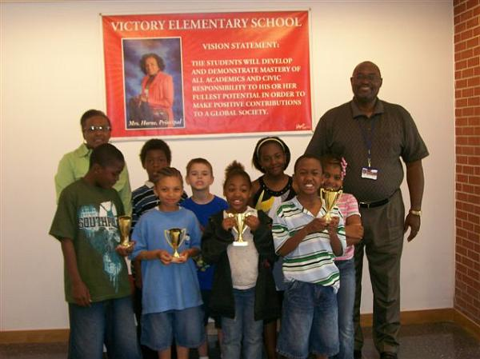
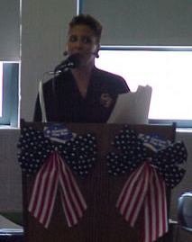
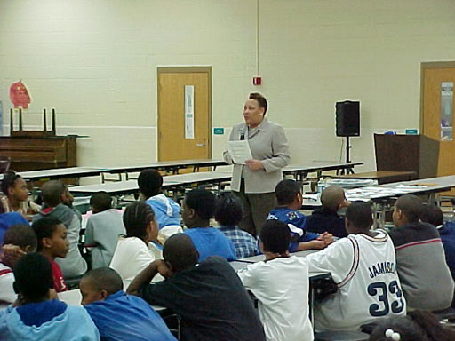
Closing Ceremony

Slide 15
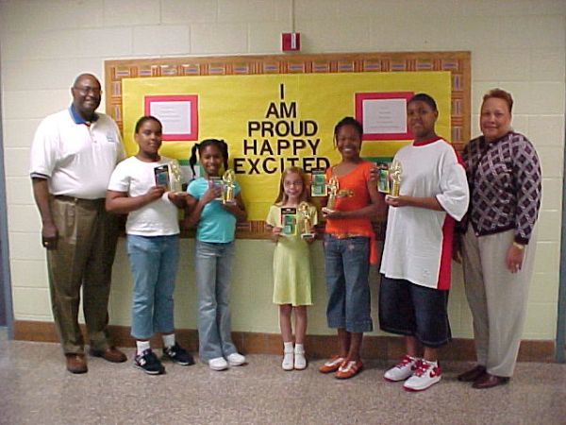
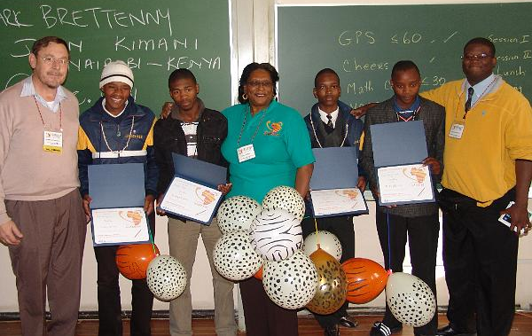
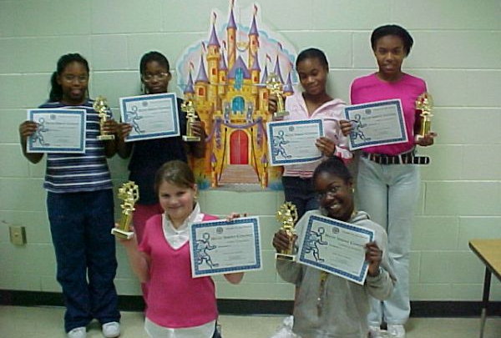
Mathematics Mentoring in a Fun Learning Environment

Slide 16
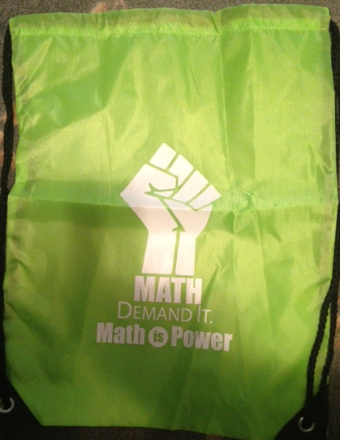
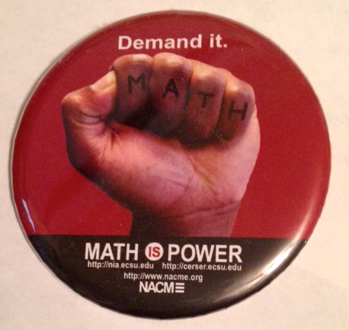
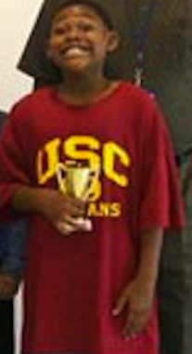
WHAT’S IN THE MATHEMATICS SPRINT KIT ?
One trophy for each of the members on the 1st, 2nd and 3rd place teams
One Certificate of Participation for each student
One Math Demand It backpack for each student
One Math Demand It button for each student
Instructions
Filler activity with Answer Key
Grading sheet

Slide 17
Host a Mathematics Sprint Competition
STEM IS IN, IN THE EASTERN AREA !!!!!!
A selection of what you’ll find in the Math Sprint Toolkit:
• Math Sprint instructions
• Grading sheets
• Certificates
• Trophies
• Filler activities
Mathematics Sprint Competition is a fun way to improve attitudes towards mathematics and improve scores on mathematics standardized test.

Slide 18
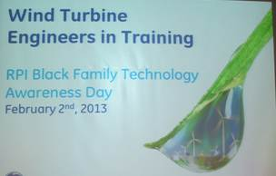
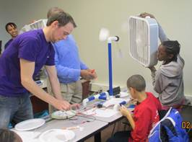
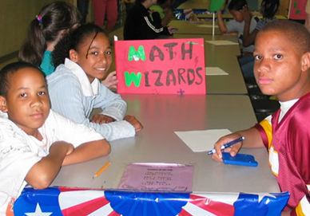
Keep “STEM-ulating”, as Link Argentina says!
Eastern Area STEM Success
• The Old Dominion Chapter – NASA SoI grant
• The Portsmouth Chapter - NASA SoI grant
• The Silver Spring Chapter - NASA SoI grant
• The Harbor City Chapter - Chevron grant
• The Wilmington Chapter – Math Sprint Model
• The Newport News Chapter’s support for 1 pre-service elementary teacher ($1000) at the NASA/National Institute for Aeronautics Pre-Service Teacher Institute
STEM Resources:
http://www.easternarealinks.org/stem.aspx
• STEM Toolkit
• 3 STEM Webinars: funding ideas & STEM Service Delivery Models
Please contact gnashe@verizon.net to report your chapter STEM activities. We want to celebrate your success.
Delivering and Sustaining Transformational Programs throughout Eastern Area !!!!!
2011-2013 GOALS
• Use technology (webinars, conference calls, and on-line videos) to introduce chapters to STEM mentoring models which promote achievement in mathematics.
• Conduct a workshop for 100% of the chapters at the 2013 Eastern Area (EA) Conference on STEM mentoring models.
• Establish a STEM initiative award for chapters.
• Establish a link on the EA website by Dec. 2012 containing STEM resources and opportunities for partnerships with the private sector.

Slide 19
Online Resources for the Math Sprint Model
• MOU
• Math Sprint instructions
• Grading sheets
• Certificates
• Filler activities
View examples of a Competition at:
http://wnyt.com/article/stories/s3452078.shtml
http://mmt.cs.ecsu.edu/nia_photo_library/09summer/igarss09/slides/090720-igarss09-297.html

