Slide 1
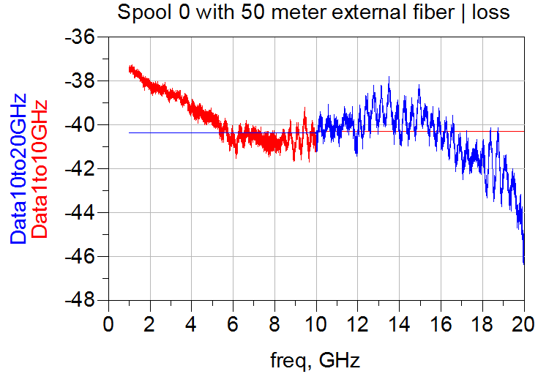
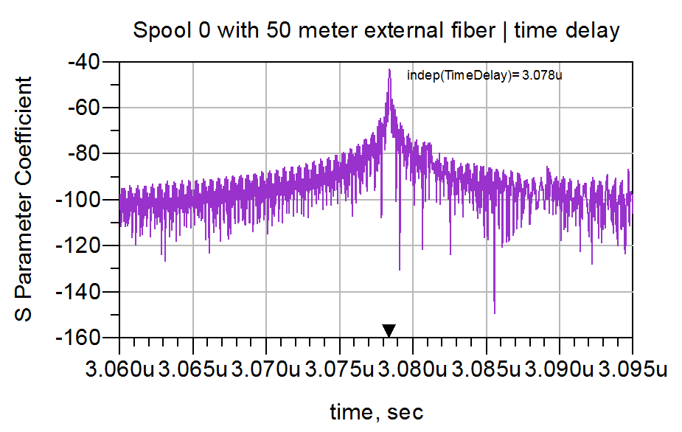
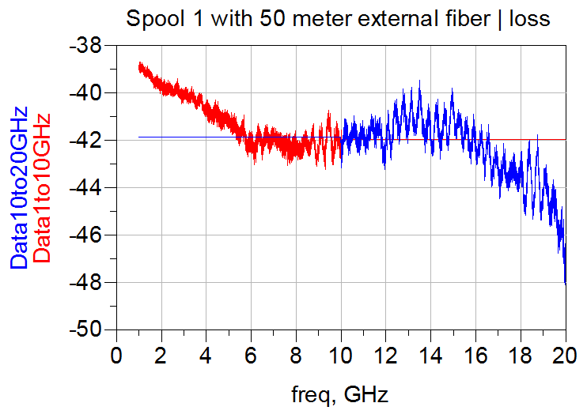
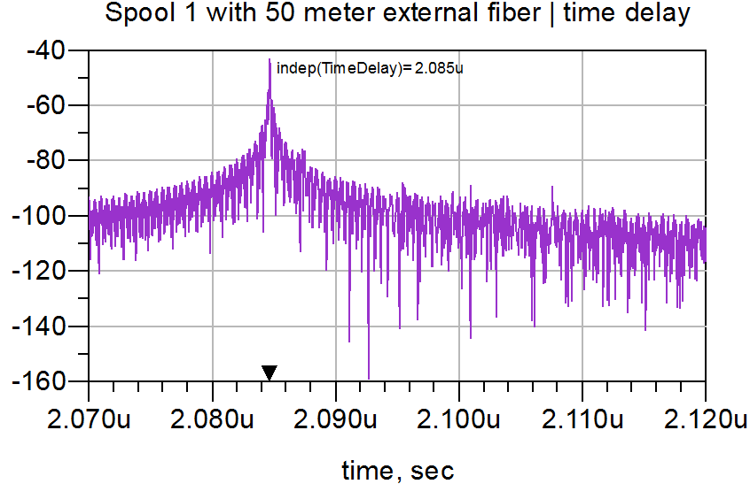
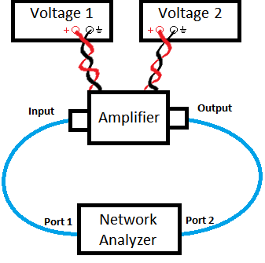
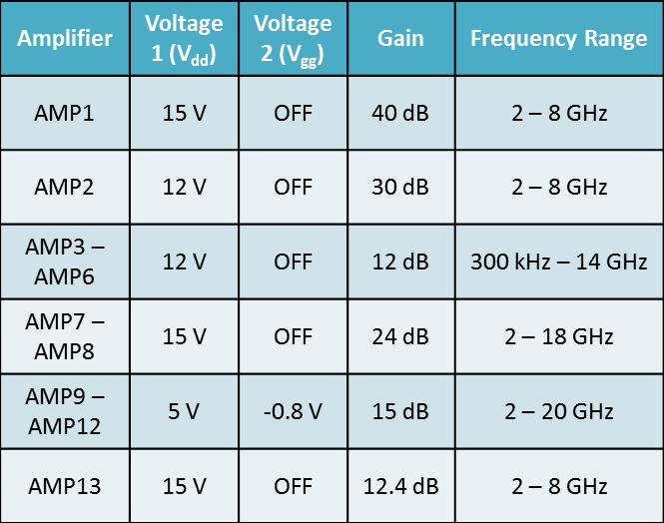
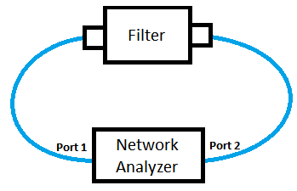
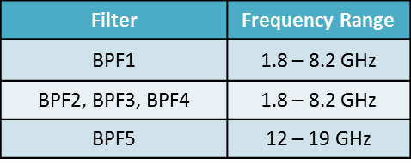
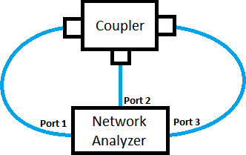
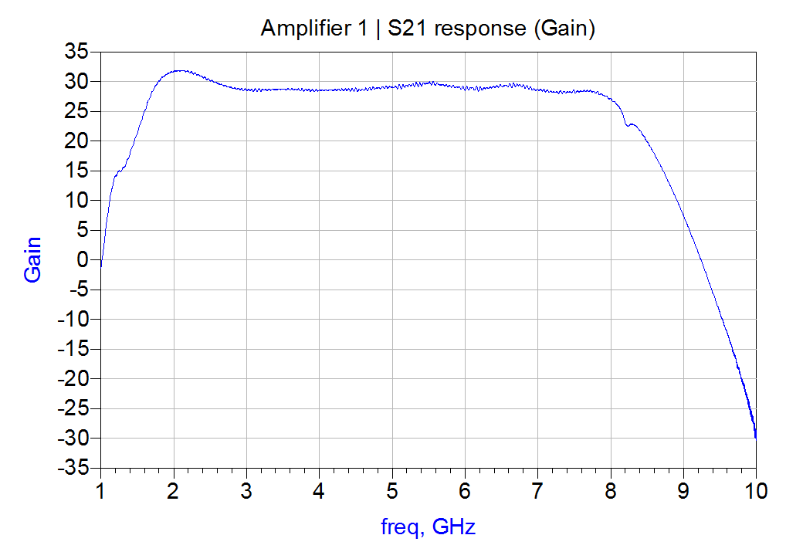
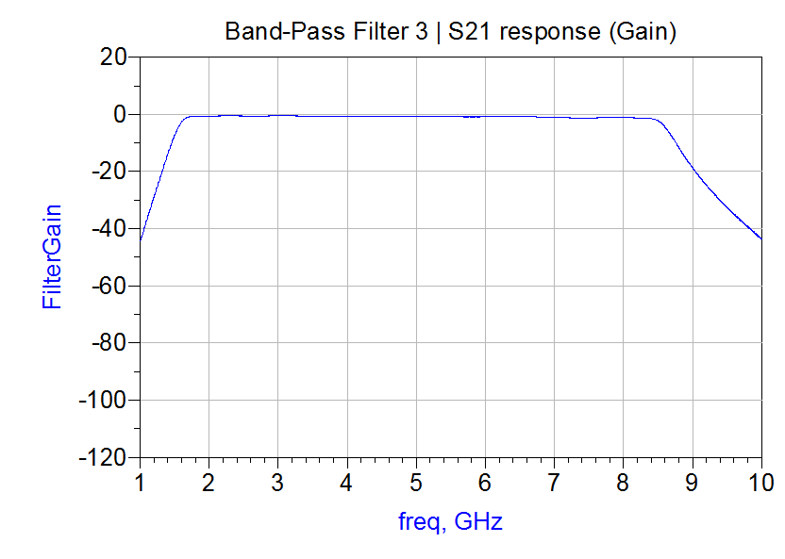
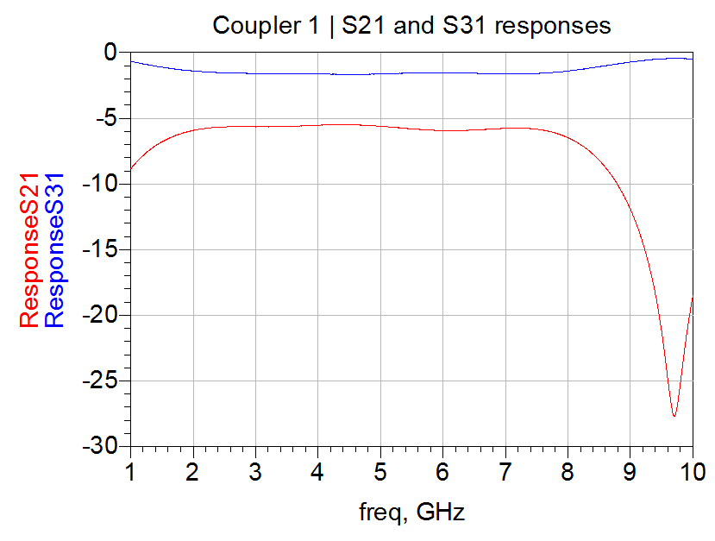
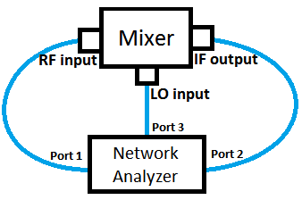
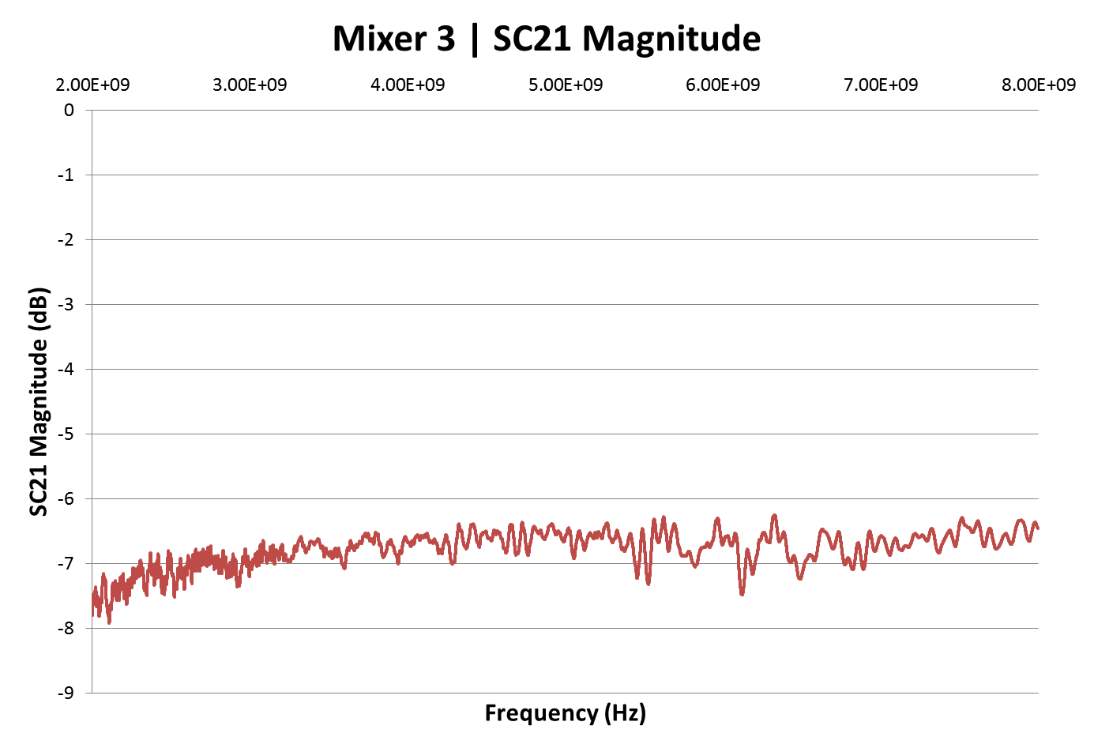
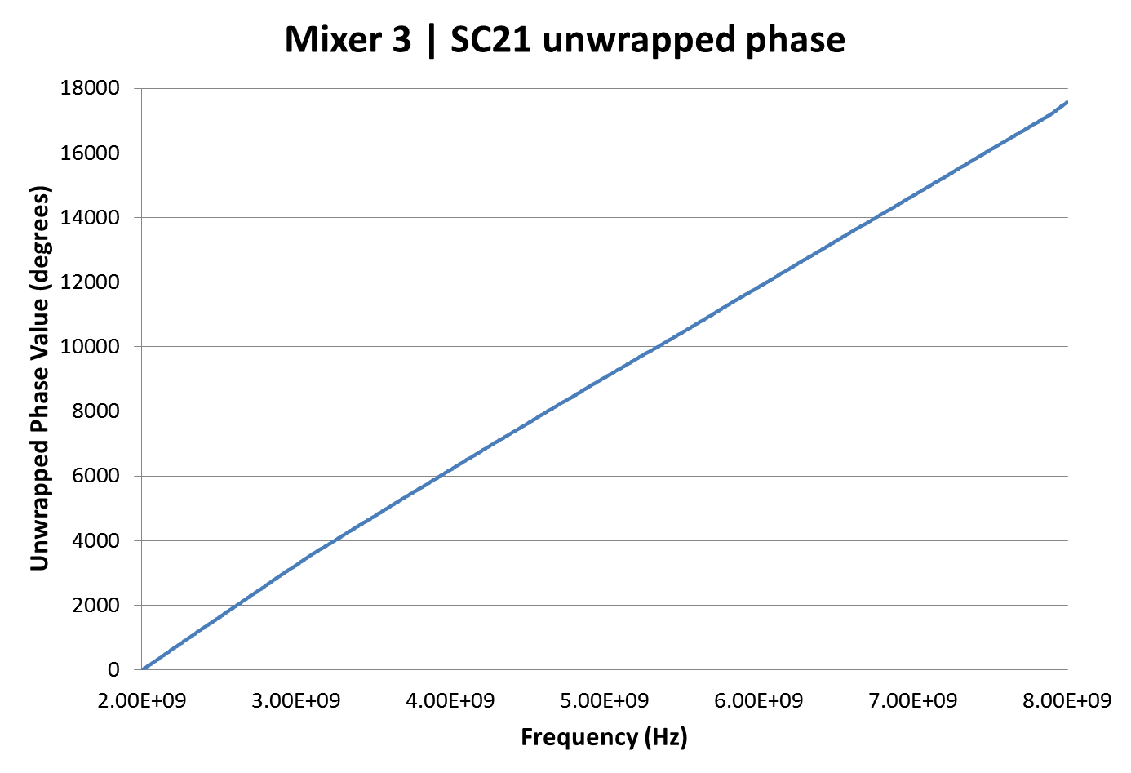
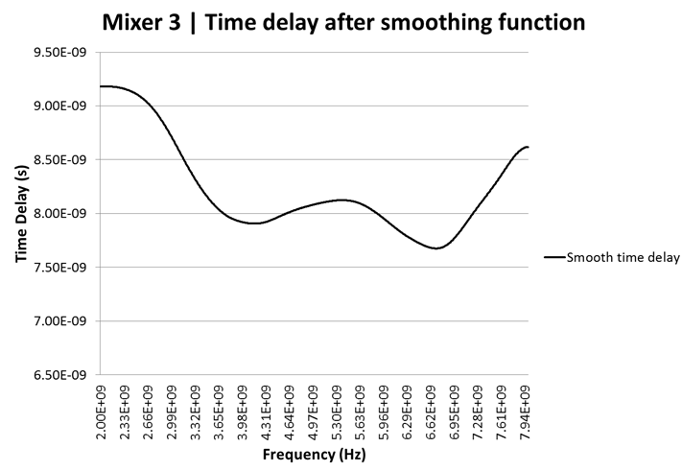
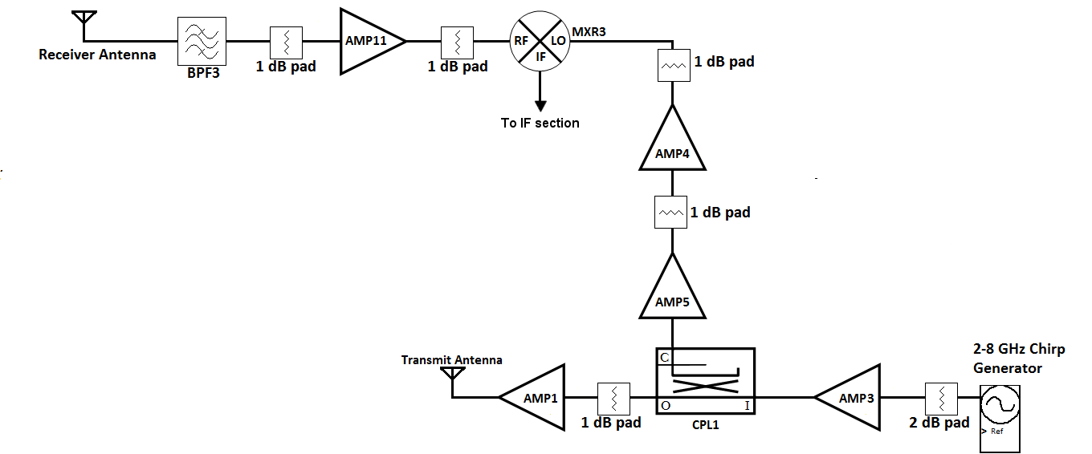
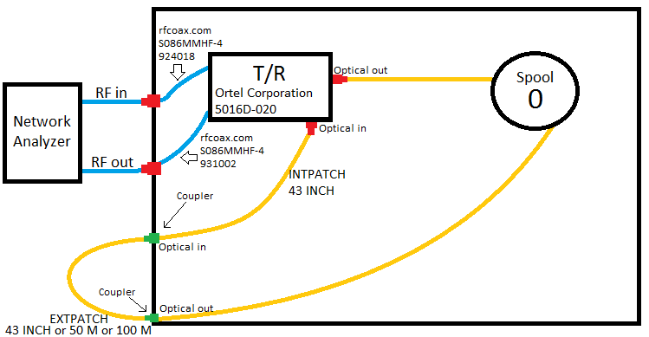
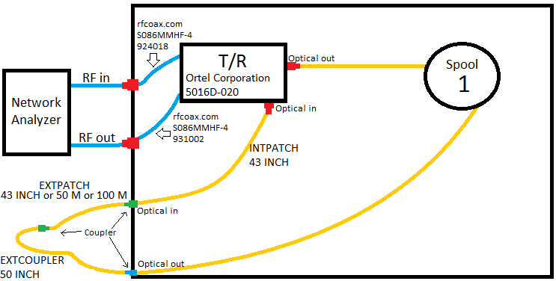
Measurements and simulations for optimization of a microwave frequency-modulated continuous-wave radar
Tamara Gaynes – Mentor: Fernando Rodriguez-Morales, University of Kansas
Introduction
These set-ups were used with frequency ranges 1 to 10 GHz and 10 to 20 GHz with a power level of -10 dBm and a 30 second sweep of 32, 001 points. These settings were found adequate for the expected time delay of the fiber lines. A full-two port calibration was performed prior to the measurements. After the measurements were taken, they were imported into Agilent ADS for simulation. Some of these results will be shown in this poster.
Frequency-modulated continuous-wave (FMCW) radars operating in the microwave region of the electromagnetic spectrum are used for remote sensing of the cryosphere. There are two FMCW radars that are deployed as part of the airborne instrument package developed at the Center for Remote Sensing of Ice Sheets (CReSIS): the “Ku-band radar” and the “Snow radar”. The Ku-band radar operates in the 12-18 GHz and is used to measure the ice surface elevation profile and map shallow internal layers with high resolution over land ice. The Snow radar operates in the 2-8 GHz range and is employed primarily to estimate the depth of snow over sea ice, although it is also used to map internal layers over land ice. Earlier versions of these radars operated as two separate radars with reduced bandwidth. but the most recent implementation operates as a dual-frequency radar.
This poster presents a summary of the work conducted as a part of the Research Experience for Undergraduates (REU) in support of the calibration and optimization of these radars.
Table 1: Amplifier parameters
Table 2: Filter frequency ranges
Figure 8: Measured insertion loss vs. frequency with Spool 0 and 50 meter optical fiber
Figure 9: Time domain response with Spool 0 and 50 meter optical fiber. The delay is 3.078μs
Figure 10: Measured insertion loss vs. frequency with Spool 1 and 50 meter optical fiber
Figure 11: Time domain response with Spool 1 and 50 meter optical fiber. The delay is 2.085μs
The next set of results correspond to the measured results from one of each type of component after importing them into the ADS simulator. The data shown is the S21 output of AMP1 and BPF3. CPL1 also includes the S31 response and MXR3 also includes the measured time delay and unwrapped phase.
Figure 4: Set-up for measuring filters
Table 3: Coupler frequency ranges
Figure 3: Set-up for measuring amplifiers
Figure 5: Set-up for measuring couplers
Objective
Table 4: Mixer parameters
There were two primary objectives of this project: (1) The first objective was to implement multiple synthetic targets using a electro-optical transceivers and a set of optical delay lines of different lengths. A set of “delay lines” was prepared and characterized with a vector network analyzer (VNA) and then used to perform calibration measurements on the existing Ku-band and Snow radars; (2) The second objective was to conduct a series of measurements on individual components of a prototype radar system using a vector network analyzer. These measurements included the use of the “offset frequency mode” of the VNA. The results from these measurements were imported into the Advanced Design System (ADS) simulator and will be used to optimize the performance of the prototype radar system.
Figure 6: Set-up for measuring mixers
Figure 12: Gain of Amplifier 1
Figure 13: Gain of Band-Pass Filter 3
Figure 14: Responses of Directional Coupler 1
2) The other set of measurements was completed with different components of a prototype radar system. There were four types of components tested, namely amplifiers, couplers, filters, and mixers. Each set-up is shown in Figures 3-6 along with tables defining different parameters for each component. After each listed component was tested for functionality and accuracy of parameters listed on the data sheet, they were put together to be tested as one unit. The block diagram of the RF section of the prototype 2-8 GHz FMCW system is shown in Figure 7.
Figure 15: SC21 magnitude of Mixer 3 (Conversion gain magnitude)
Figure 16: SC21 unwrapped phase of Mixer 3 (Conversion gain phase)
Figure 17: SC21 time delay of Mixer 3 (derived from the phase measurement) after smoothing.
Methodology
The results from individual measurements will be combined in ADS to simulate the response of the entire prototype radar as shown in Figure 7 and compare it with the measured response.
1) For the first part of the project, we performed measurements through different lengths of optical fiber. Optical fiber is a useful tool in simulating the propagation of a radar signal through free-space at the nominal flight altitude. It has very little loss, approximately 5 dB per 1 kilometer, which makes it suitable for laboratory use. These measurements were performed with the VNA using the two set-ups below. The delay line consisted of an internal spool (denoted Spool 0 or 1) and an external spool. The length of the internal Spool 0 is about 550 meters and the length of the internal Spool 1 is about 350 meters. Three different lengths of external fiber were used: 1.0922 m, 50 m, and 100 m (lengths are approximate). All different spool combinations were measured.
Summary
The response of a set of delay lines has been accurately measured using a VNA. The measured data is being used for calibration of the CReSIS Ku-band and Snow radars. Individual components of a prototype 2-8 GHz FMCW radar system, including the mixer, were characterized using a VNA. All the measured values agree with the specifications provided by the manufacturer. The measured results were imported into Agilent ADS to perform a system-level simulation of the complete system. The simulations will be compared with the measured response of the complete system.
Acknowledgements
Figure 7: Block diagram for radar set-up
Dr. Fernando Rodriguez-Morales, Research Professor – EE&CS, CReSIS
Dr. Prasad Gogineni, Director, CReSIS
Dr. Ron Hui, ITTC Faculty, Professor, EECS
Daniel Gomez-Garcia, PhD Student
Bryan Townley, Research Assistant
Jay Fuller, Masters Student
Jeff Wood, Multi-Media Technician
Darryl Monteau, Education Coordinator
Center for Remote Sensing of Ice Sheets (CReSIS)
National Science Foundation (NSF)
National Aeronautics and Space Administration (NASA)
Results
Figure 8 and Figure 10 show the loss of two of the fiber optic delay lines as measured with the network analyzer. The loss is frequency dependent but stays within 4 dB of variation over the 2-18 GHz range. Figure 9 and Figure 11 show the time delay after performing an inverse Fourier transform on the frequency domain data. The measured delay for Spool 0 with a 50-m external spool is 3.078 us. The measured delay for Spool 1 with a 50-m external spool is 2.085us. It is worth noting that for the calibration measurements, the important parameter is the time delay and not the physical length of the fiber.
Figure 1: Experimental set-up measuring optical fiber with Spool 0
Figure 2: Experimental set-up measuring optical fiber with Spool 1

