Slide 1
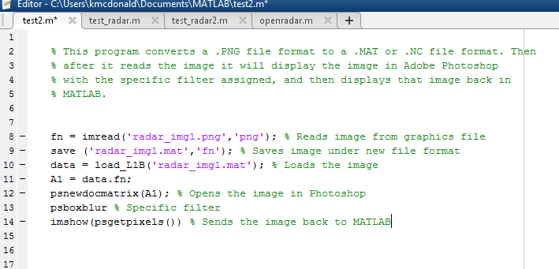
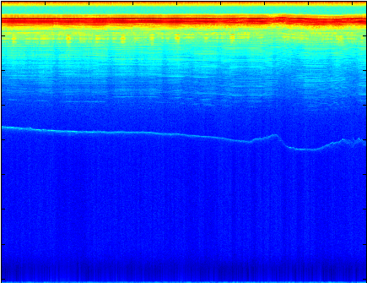
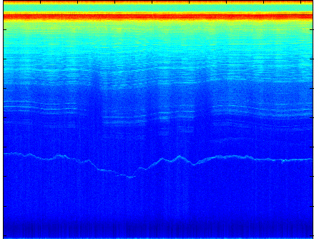
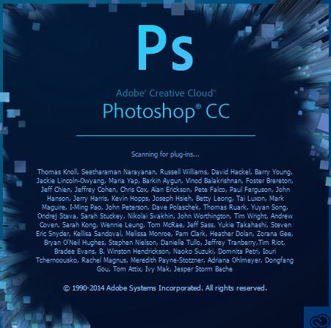
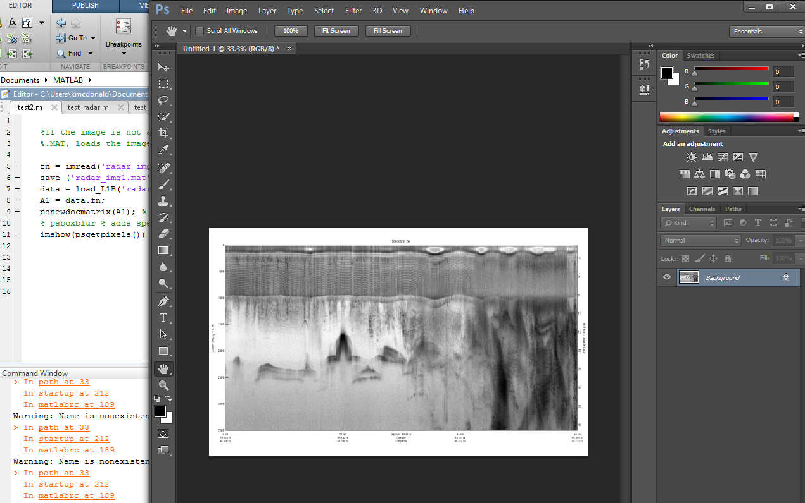
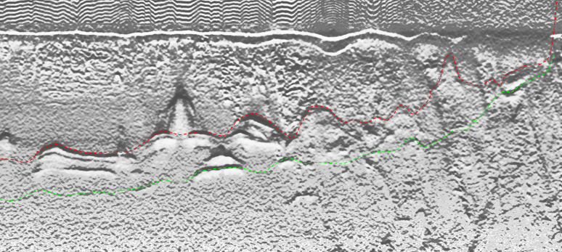
Using a MATLAB/Photoshop Interface to Enhance Image Processing in the Interpretation of Radar Imagery
Kalyx McDonald Mentor: John Paden
Mississippi Valley State University The University of Kansas
Abstract
MATLAB & Adobe Photoshop Interface
Methodology
The Center for Remote Sensing of Ice Sheets (CReSIS) has developed many radars that operate over the frequency range from 140 to 230 MHz with multiple receivers developed for airborne sounding, and imaging of ice sheets. Understanding the echogram data depends on knowing the process of how radar waves interact with natural surfaces. The purpose of this project was to use the Bas Relief filter for image processing in order to improve the interpretation of radar imagery. The filter, Bas Relief, is named after a sculpture technique in which figures or other design elements were just barely more prominent than the overall background. The University of Kansas CReSIS office heavily relies on the use of MATLAB along with Photoshop to perform several tasks. MATLAB is a high-level programming language and interactive environment with strong mathematical and graphics capabilities while Adobe Photoshop CC allows you to use advanced image processing algorithms that are not available in MATLAB. With Adobe Photoshop Extended we hoped to combine MATLAB commands with Photoshop’s image editing features to further interpret imagery. With the implementation of this algorithm in MATLAB, it would allow researchers to conveniently retrieve and use the newly edited image. By comparing the original image versus enhanced, researchers would be able to improve tracking of features such as internal layers and the ice bottom.
The MATLAB/Photoshop Interface allows users to access images in Photoshop directly from MATLAB commands and the Photoshop toolbox. New enhanced images could be used for continued research and image quality. Researchers could run image processing techniques and see results as if it was directly edited within Adobe Photoshop.
In order to first begin the automated approach, installation of the Photoshop and MATLAB path had to take place. Upon completion of that several workshops about MATLAB took place to teach the fundamentals. After completing the workshops then trial programs were ran in order to produce the correct function format. Test cases of a smaller program simply opened radar echogram data by itself. The first effective program converted the selected image to the correct file format, sent the image to Photoshop, applied the specific filter, and then returned the image back into MATLAB. After several test cases, a final program was created. It would allow the user to send the selected radar echogram data from the load radar function. The load radar function simply loads CReSIS echogram data files saved on the network. After the data was loaded a scaling function was applied to adjust the size. The re-scaling function scaled the image between 0-255 and a uint8 data type for 8 bit integers. After being scaled the Psnewdocmatrix function was applied. This created a new document in Photoshop with the sent image. While the sending process occur, the selected filter was applied, and then Psgetpixels was called from the Imshow function. This gathered the pixels of the current image in Photoshop and directly opened it in MATLAB along with Photoshop.
Future Works
Radar Echogram
To complete this research first the re-scaling function must be corrected. In order to use the appropriate radar echogram, It should be re sized to 0-255 and a data type conversion of uint8. Although it did that, the image is missing its color. All regular images will fall under the requirements by default. Next, attempt at sending not only 8-bit channel images but also 16-bit and 32-bit channels. Lastly, the Bas Relief operation must be written. Because the Photoshop functions seem to be based off the JavaScript functionality, script listener could be used. With script listener it will allow access to view what has happened from Photoshop live. It would log any current happenings from Photoshop and from there be used to recreate the filter Bas relief in MATLAB.
These images have helped researchers scan over ice surfaces to study the depth. Depth edges can often show clues toward the understanding and interpretation of image transformation. A radar echogram is generated by collecting these reflected signals as the aircraft flies over the target. From above a pulse is transmitted to the ground, if it hits a new layer, a signal wave is returned to the aircraft. After looking at the time of propagation to the reflection, we can estimate the depth of the layer in the ice.
References
[1] N. S. F. "The Center for Remote Sensing of Ice Sheets (CReSIS) Investigates Melting Polar Ice," 25 February 2013. [Online]. [Accessed 23 June 2014].
[2] P. A. Mlsna and J. J. Rodriguez, "Gradient and Laplacian Edge Detection," in Handbook of Image & Video Processing, Burlington, Elsevier Incorporated, 2005, p. 1372.
[3] S. Esaak, "Bas Relief," [Online]. Available: http://arthistory.about.com/od/glossary_b/g/bas_relief.htm. [Accessed 2 July 2014].
[4] "New Employee Setup Guide," CReSIS, 4 June 2014. [Online].Available:https://wiki.cresis.ku.edu/cresis/New_Employee_Setup_Guide#Setup_startup.m_.28MATLAB.29. [Accessed 2 July 2014].
[5] Adobe Systems Inc., "Photoshop Toolbox," 2006. [Online].Available:http://ftp.comprousa.com/downloadfiles/nicole/Photoshop%20cs3/MATLAB/psfunctionscat.html. [Accessed 2 July 2014].

