Slide 1
Using a MATLAB/Photoshop Interface to Enhance Image Processing in the Interpretation of Radar Imagery

Slide 2
Kalyx McDonald Mississippi Valley State University
Mentor
John Paden
The University of Kansas

Slide 3
Overview
Abstract
Purpose
Introduction
MATLAB/Photoshop Interface
Bas Relief
MATLAB/Photoshop toolbox
Radar Echogram
Example programs
Scrip Listener
Conclusion
Future research
Acknowledgements & Questions

Slide 4
Abstract
The Center for Remote Sensing of Ice Sheets (CReSIS) has developed many radars that operate over the frequency range from 140 to 230 MHz with multiple receivers developed for airborne sounding, and imaging of ice sheets. Understanding the echogram data depends on knowing the process of how radar waves interact with natural surfaces The purpose of this project was to use the Bas Relief filter for image processing in order to improve the interpretation of radar imagery. The filter, Bas Relief, currently in Photoshop, was once a sculpture technique in which figures or other design elements were just barely more prominent than the overall background. The University of Kansas CReSIS office heavily relies on the use of MATLAB along with Photoshop to perform several tasks. MATLAB is a high-level programming language and interactive environment with strong mathematical and graphics capabilities while Adobe Photoshop CC allows you to use advanced image processing algorithms that are not available in MATLAB. With Adobe Photoshop Extended we hoped to combine MATLAB commands with Photoshop’s image editing features to further interpret imagery. With the implementation of this algorithm in MATLAB, it would allow researchers to conveniently retrieve and use the newly edited image. By comparing the original image versus enhanced, researchers would be able to improve tracking of features such as internal layers and the ice bottom.
Notes:
Summary of my abstract:
CReSIS has several Radars for the analyzing of ice sheets
What Bas Relief is – explain more in the pp
Introducing you to MATLAB & Photoshop
What we hope to accomplish – See in a second

Slide 5
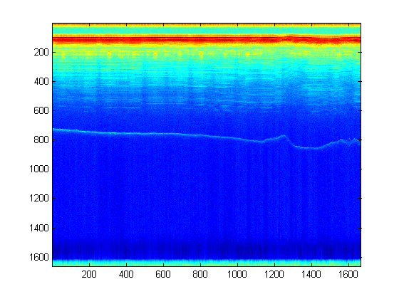
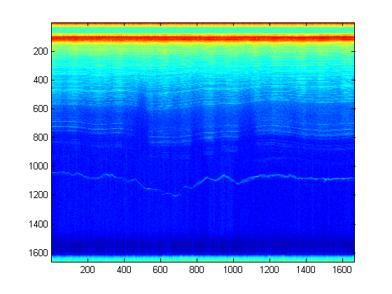
Purpose
Use the Bas Relief filter for image processing in order to improve the interpretation of radar imagery.
Notes:
Wanted to use the filter Bas Relief in order to improve radar imagery
Go about it at a different angle
Use an MATLAB/Photoshop Interface to automatically enhance the images using Bas Relief

Slide 6
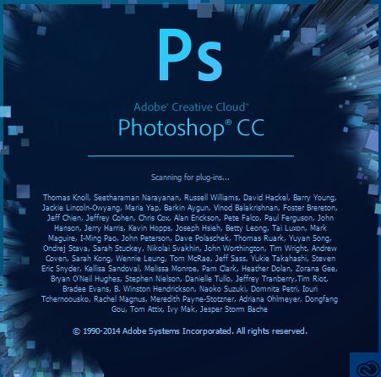
MATLAB/Photoshop Interface
Photoshop JavaScript interface and the MATLAB library interface.
Not many people have worked with this yet
Very powerful tool
Notes:
Integration between MATLAB and Adobe Photoshop CC respective processing toolboxes
Allow you to edit & enhance images from the MATLAB script using a wide range of Photoshop functions.
The idea is that you will be able to apply certain Photoshop operations on the image you pass from MATLAB.
psfunctionscat.html
helpx.adobe.com/photoshop/using/photoshop-matlab-photoshop-extended.html#about_photoshop_and_matlab

Slide 7
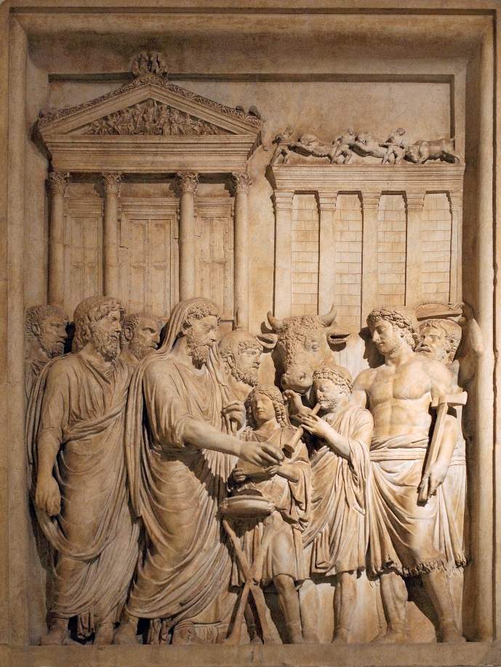
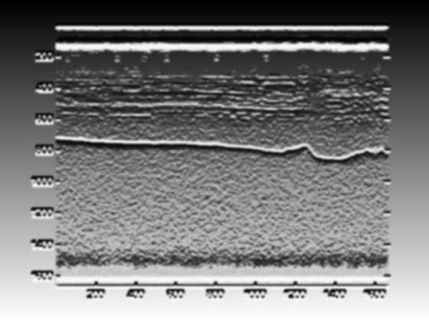
Bas Relief
Type of edge detection
Eliminates all vertical and horizontal blank spots in the image
Notes:
Created in the late 1970’s
A kind of sculpture in which shapes are carved so that they are only slightly higher than the flat background
Edge detection - finding the boundaries of objects within images. (outline of image)
http://www.merriam-webster.com/dictionary/bas-relief

Slide 8
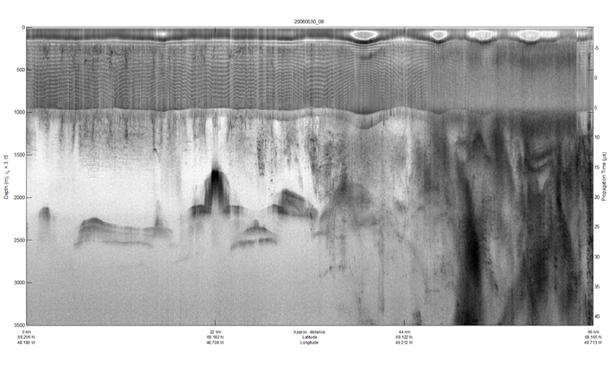
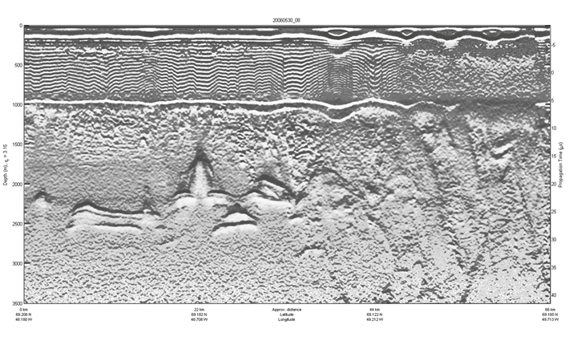
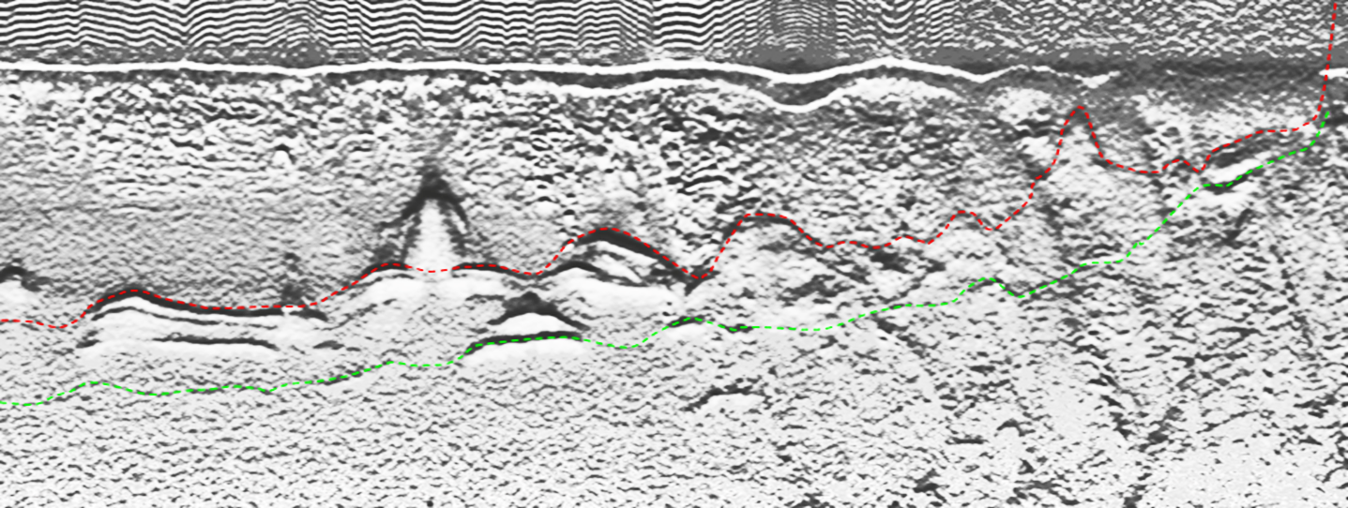
Notes:
Original echogram
Once Bas Relief is added, unclear visuals clear up
Made it easier to pick the image
Why do we pick the image?

Slide 9
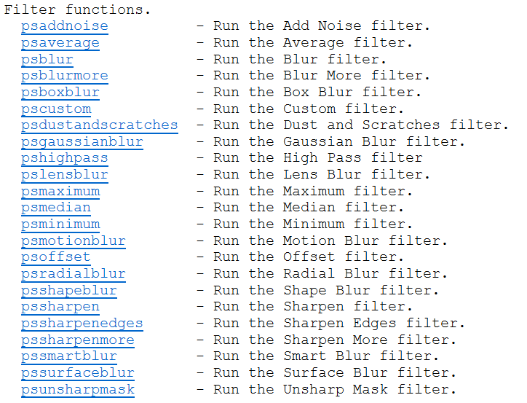
Photoshop Toolbox
Psnewdocmatrix – creates a new Photoshop document from a matrix ands send an image from in MATLAB
Psgetpixels() – reads the pixel data of the current visible layer back into MATLAB
Notes:
Enables communication between Photoshop and MATLAB
Lets you access images in Photoshop directly from the MATLAB command line
Able to run Photoshop image processing routines in MATLAB and see the results

Slide 10
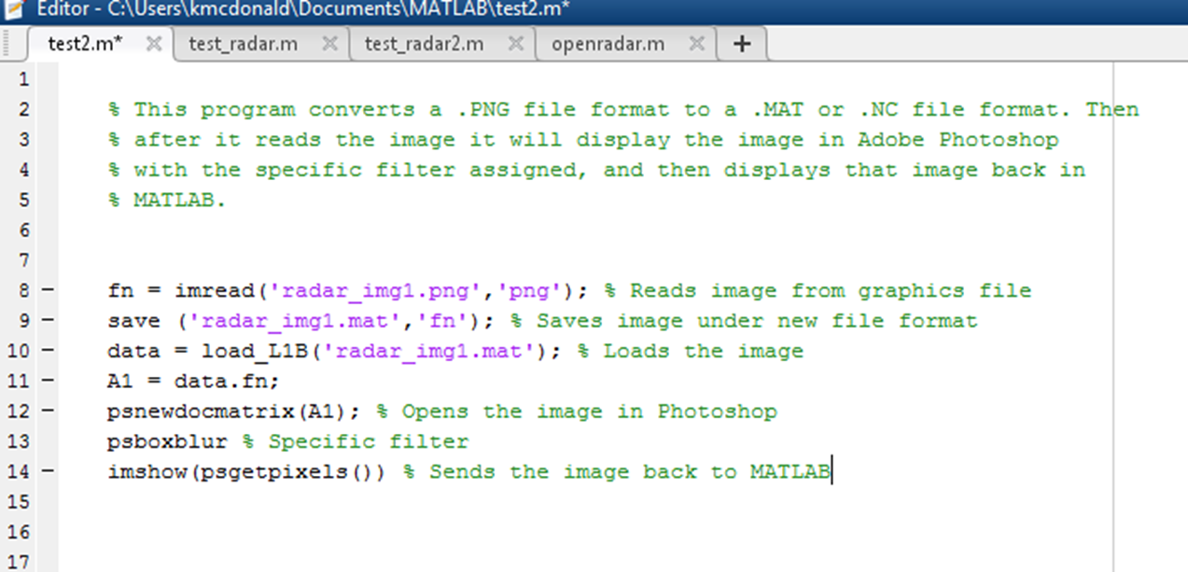
Example program
Notes:
Things that had not happened yet
Any image, hence converting into the correct format
Was not the BAS Relief
Coverts & Saves
Loads & Sends image
Apply filter
Opens in MATLAB along with still running in Photoshop

Slide 11
“Final” Draft
Notes:
Bas relief still is not applied
Data is loaded while converted to an image
Scaled it using 8 bits to make sure the actual image appears rather than a blank screen
Sent to Photoshop
Filter is applied
Calls the image from Photoshop and opens in MATLAB also

Slide 12
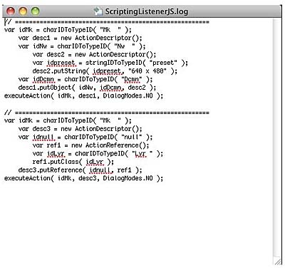
Script Listener
AppleScript – Mac OS
VBScript - Windows
JavaScript - Both
Notes:
These three are scripting languages
Because the Photoshop functions seem to be based off the JavaScript functionality, script listener could be used.
commands that tells Photoshop to perform specific actions. Ex: applying different filters to selections in an open document
script listener would log any current happenings from Photoshop and from there be used to recreate the filter Bas relief

Slide 13
Conclusion
Provided a new technique for researchers
MATLAB workshops
Extensive test programs
Notes:
My purpose was to use Bas Relief filter to improve radar imagery.
MATLAB Tutorials with Weibo to learn the fundamentals
Load the path that allowed communication between the 2 programs
Trial Programs
Created more than just the 2 you saw
Bas relief does help clear up the noise.
Images I saw before and after I could tell a difference.
Will improve radar imagery and once its crated it will be a big milestone.

Slide 14
Future Research
Re Scaling function
Multiple Images
Script Listener
Bas Relief operation must be written
Notes:
Re write the function for 16 bit and 32 bit numbers.
Also work on sending those images also to Photoshop.
Try to send and edit more than one at a time.
Less time consuming doing just one image at a time
Errors with script listener.
Ran out of time before I could find the exact problem.
It does work so just a matter of time
If script listener fails other methods
Recreate the filter on your own
Lot of work, and much more research

Slide 15
I would like to thank CReSIS for the opportunity to continue performing research with the program.
John Paden for assisting me even while out of the office
Darryl Monteau and the rest of the CReSIS staff at KU for making us feel at home.
Notes:
http://wwwimages.adobe.com/content/dam/Adobe/en/devnet/photoshop/pdfs/photoshop_scripting_guide.pdf – scripting guide
Http://ftp.comprousa.com/downloadfiles/nicole/Photoshop%20cs3/MATLAB/pstoolbox.html - photoshop tool box
http://dsp.vscht.cz/konference_matlab/MATLAB10/full_text/058_Krulakova.pdf – photoshop/matlab
http://www.mugginsoft.com/html/kosmictask/ASDictionaryDocs/Adobe/Photoshop/OS-X-10.7/Photoshop-CS5/html/ - photoshop dictionary

