Slide 1
An Accuracy Assessment of the Polar MM5 Snow Accumulation Model
Jared Carse
Mentors: Dr. David Braaten, Dr. Claude Laird
Graduate Mentors: Aaron Gilbreath, Mitch Oswald

Slide 2
Polar MM5 Model
Fifth Generation Mesoscale Model modified for polar climates
Developed by Burgess et al.
  “A spatially calibrated model of annual accumulation rate on the Greenland Ice Sheet (1958–2007)”
Calibrated using firn cores and meteorological station data
Spans year 1958-2007
Raster data set

Slide 3
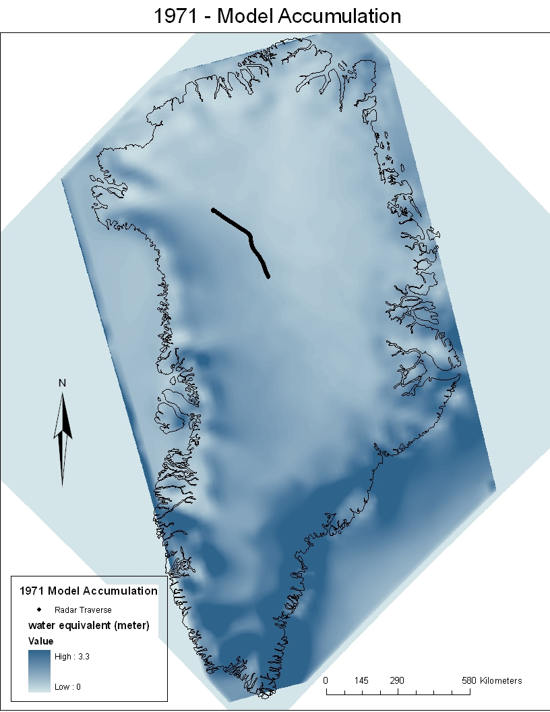
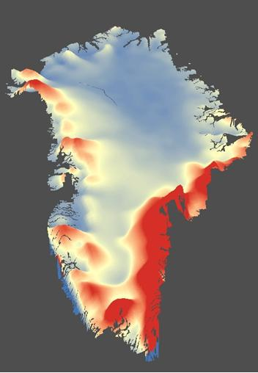

Slide 4
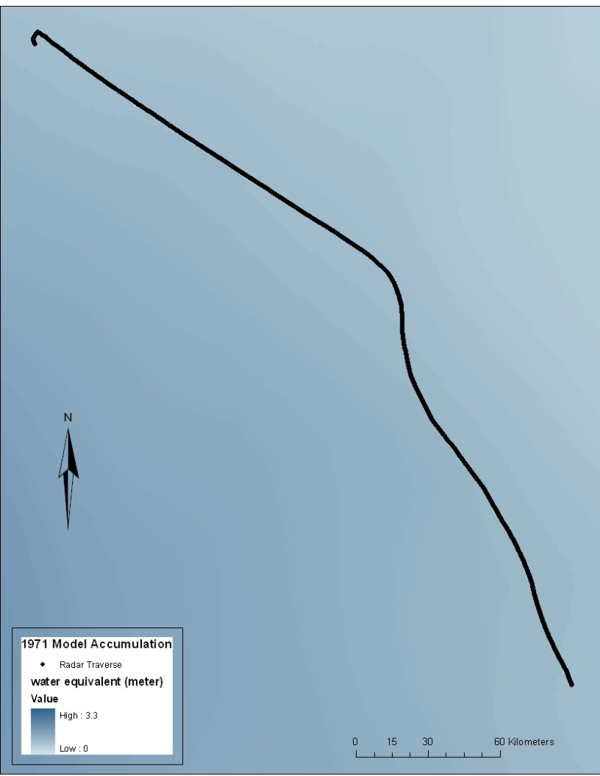
Radar Traverse
375 kilometer traverse from NGRIP to NEEM
Snow Accumulation Radar
Layers traced in MatLab
NEEM
NGRIP

Slide 5
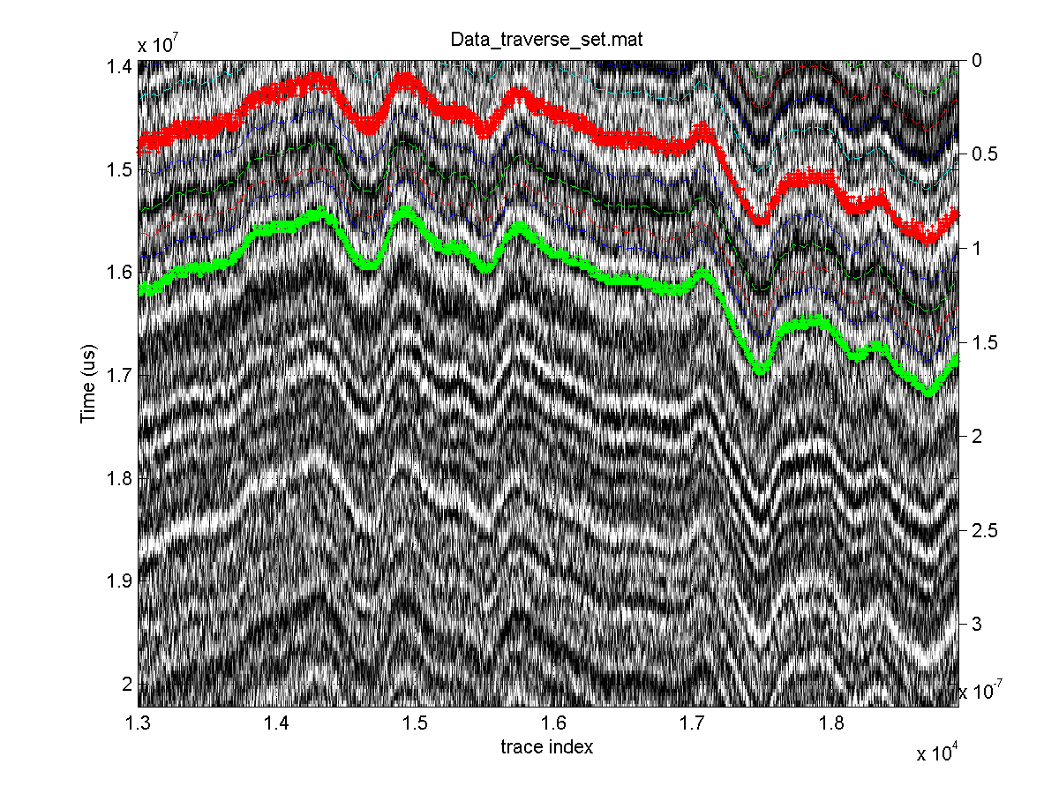

Slide 6
Converting Radar data
Extract the thickness of between annual traced layers
Convert the water equivalent units using ice core density profiles
Density interpolated between NGRIP and NEEM density profiles

Slide 7
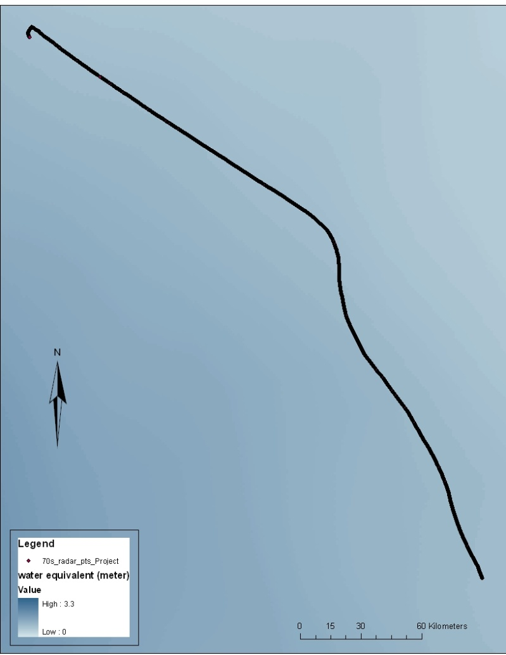
Import Radar Data into ArcGIS
Each layer extracted from MatLab has Lon/Lat coordinates
Projected into the same coordinate system that the Model raster data uses

Slide 8
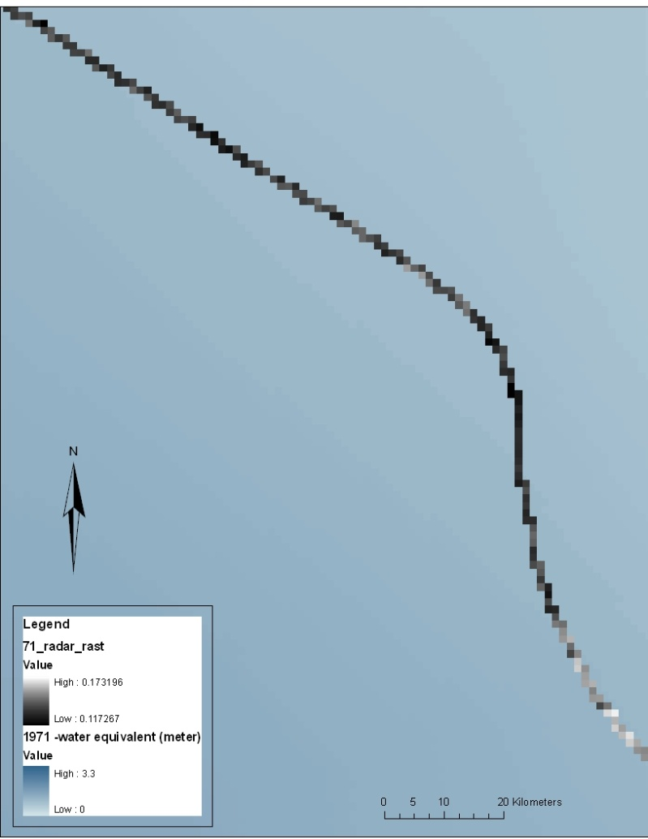
Convert Radar Data to Raster
Same spatial resolution is needed to accurately compare between radar and model
  Mean of points that lie in each pixel
Raster Calculator used to form error assessment

Slide 9
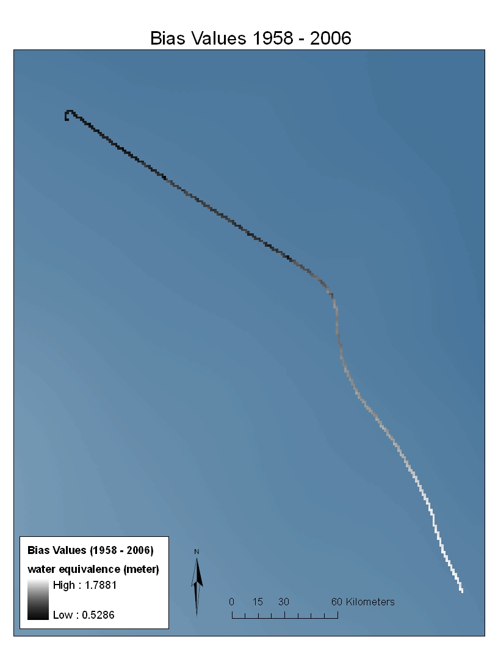
Model Error and Bias
Average RMSE = 40.598 mm

Slide 10
Model st. dev. = 21.834 mm
Radar st. dev. = 26.211 mm

Slide 13
NAO - Radar
Correlation = .081642
Photo extracted from /www.ldeo.columbia.edu/res/pi/NAO/

Slide 14
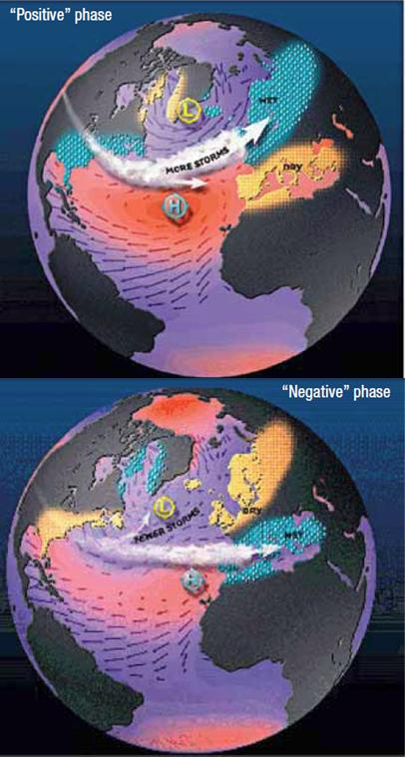
NAO – Ice Cores
Correlation
0.22803
correlation
-0.17534

Slide 15
Summary of NAO
From ice core data
  Negative NAO year produce higher accumulation at NEEM
  Positive NAO years produce higher accumulation at NGRIP
To be statistically significant
  At alpha = 0.10
  Correlation = .243
  The largest correlation occurs at NGRIP ice core with correlation = .22803
  Therefore the relationship between NAO and accumulation is not significant. A larger sample size is needed, i.e. more years need to be measured

Slide 16
How well does the model perform?
Ice core bias = 17.545 mm
Radar bias = 34.355 mm
Model compared to both radar and ice cores, consistently over-predicts

Slide 17
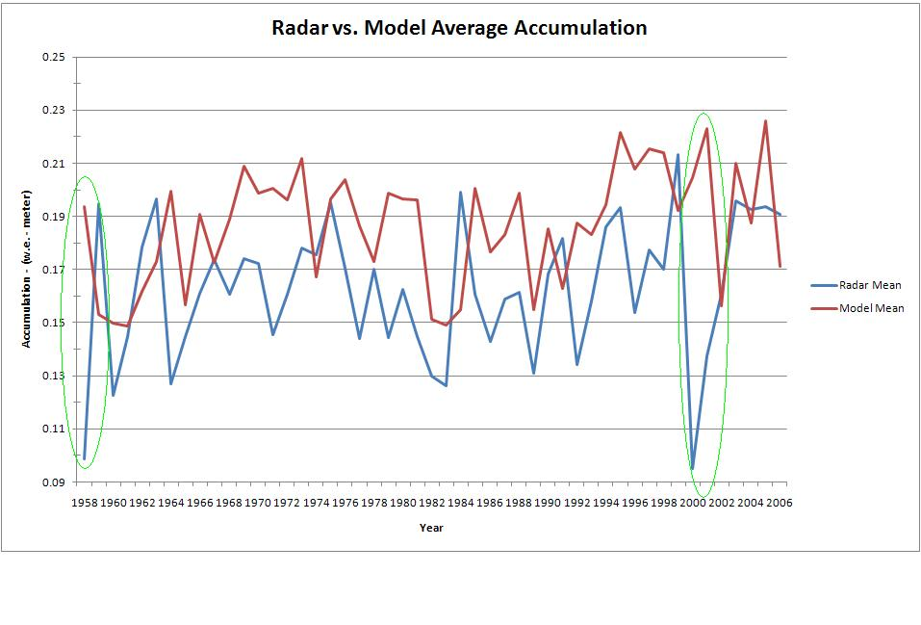
Future uses of model
Could be used as tool to help trace layers
  Model corresponds with ice cores fairly well
  Large-scale coverage rather than point sources that ice cores give us

Slide 18
Caveats
The model accumulation is set annually, January 1 – December 31
Radar layers can be variable
  Large storms could produce layers that appear to be annual
Model appears to be less variable than accumulation detected through radar

Slide 19














